Slide 1

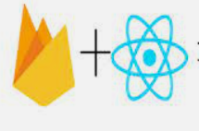


ReactJS Project on Instagram Clone using Firebase and Spring JPA
+
=

Slide 2
Submitted by Team A
Group Members Roles
DEBANGSHU DIKPATI Group Leader and Project Coordinator, React JS coding, Back-end coding(Spring data Jpa)
ANIMESH ROY CHOUDHURY Software Testing
G NITHISH REDDY ReactJS Coding, firebase

Slide 3
Project Abstract
The name of our project is Instagram Clone using ReactJs, Springboot and firebase which aims at giving an experience similar to that of Instagram. Now a days with the growth of technology there has been a tremendous increase in the number of social apps where people can share videos, photos, messages, posts, contents etc. So the main aim of doing this project is to get a better idea of the software and applications that are functional in the present scenario.
Now coming to the functionalities, there is a method to register/login into the application. Upload and delete posts, comments, display stories etc. We aim at providing good UI service to the users and hope to upgrade this clone further in the coming future.

Slide 4
Firebase???
So everyone has always been curious about firebase. What is it ? What purpose does it serve?
To clear almost every doubt we would like to explain firebase in our own terms. Firebase is basically nothing but more like a real time database that helps the programmers to save their application/software data and fetch and render as and when required. It is possible to make a working project just by using reactjs and firebase alone. Therefore in layman’s language it helps to solve the issues of the backend and make things too easier for the programmers.

Slide 5
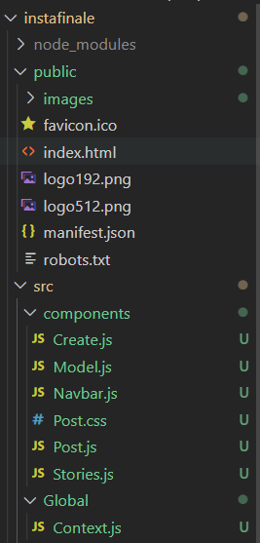
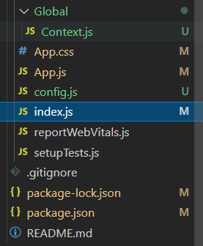
File Structure
This is the basic file structure in the ReactJS Visual Studio. We have the components folder consisting of all the necessary .js files required for the web application.
We also have the config.js file consisting of firebase details and configuration.

Slide 6
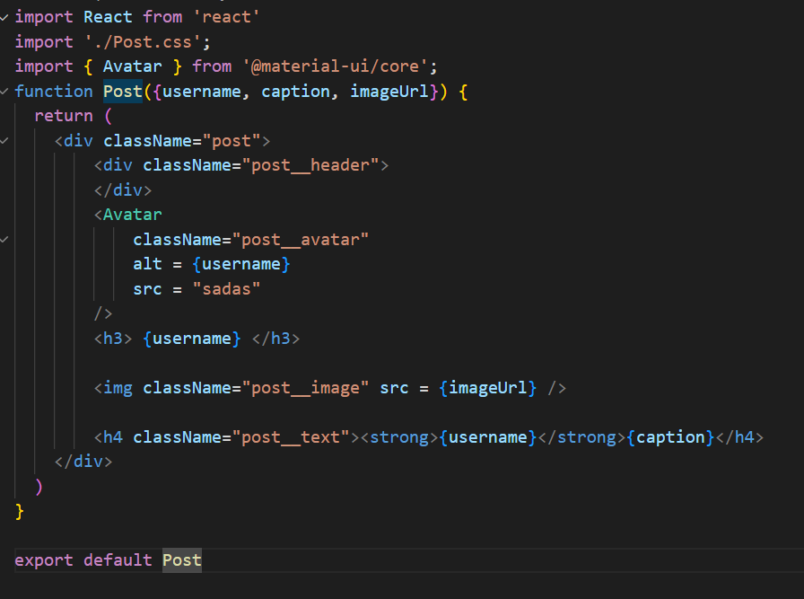
Post.js code snippet
The posts are being displayed on the screen with the help of the post functional component which is then exported and imported in the App.js to file. By using proper useState methods and key id and arrow operator we are able to render it on the main screen.

Slide 7
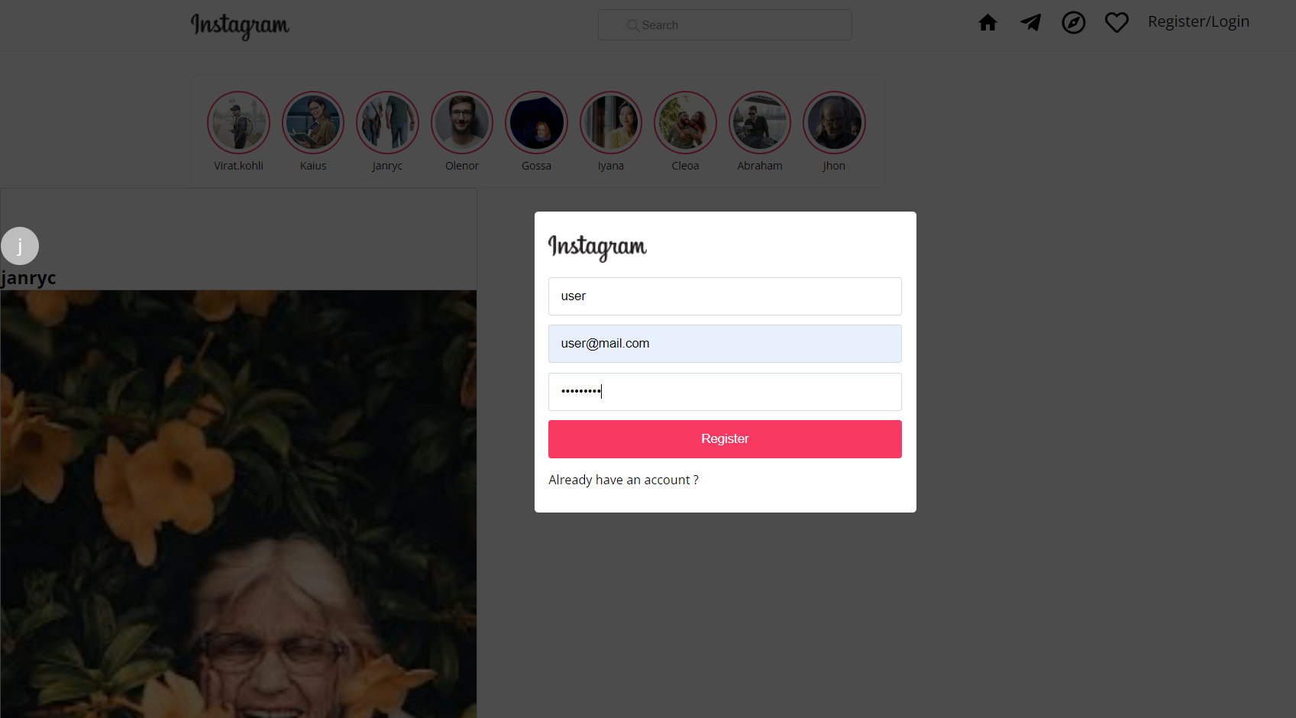
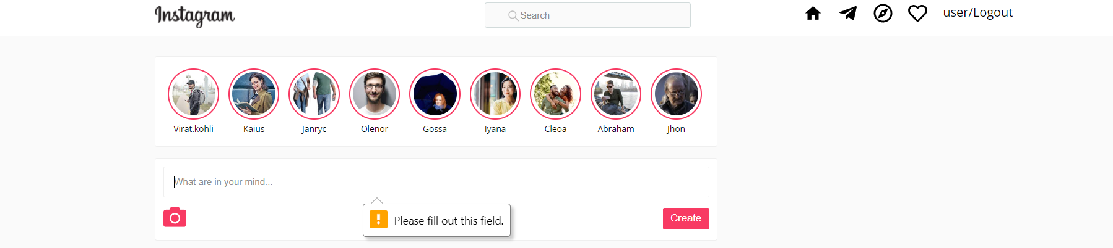
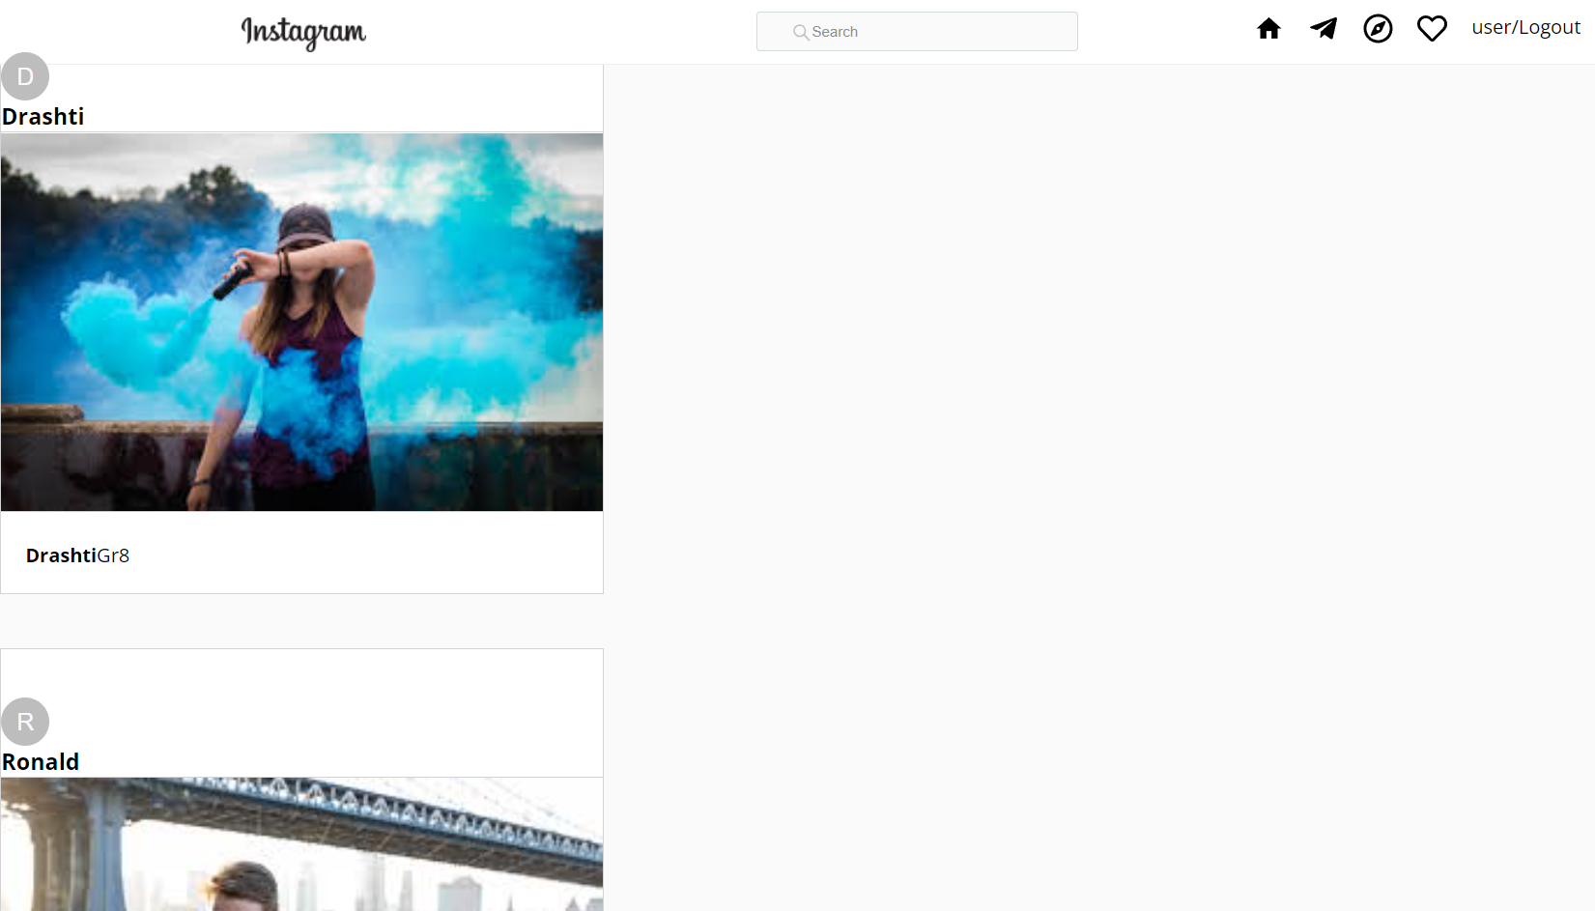
Instagram clone view

Slide 8
Outcomes of the project
Understanding the implementation of ReactJS along with Spring Data JPA and firebase.
Simplifying and enhancing the UI operations.
Robustness is achieved.
Secured interface.

Slide 9
Future Scope
The interface can be given a facelift in the future by using new css properties and material-ui modules.
It can be made more interactive by including several other operations.

Slide 10


